Slide 1

The Aldous Huxley Centre Workshop
Objective: To develop a range of creative and engaging approaches for teaching Aldous Huxley’s ‘A Brave New World’

Slide 2

Create an Advertisement for Soma
Why do people use Soma and what are the benefits of it?
What slogan is used in the novel?
Will you keep, change or develop the slogan?
Choose which form you’ll use to advertise Soma:
Newspaper Advert
Billboard/ Poster Advert
Radio Jingle
TV/ Tick Tock Advert
Internet Pop-Up
5. Use the Success Criteria on the previous slide

Slide 3


Your Task: To Create and Market a Dystopian Product Ready For Consumption
1. Make a list of products you think people living in a dystopian world would be interested in purchasing and why?
2. Select one of those products and market it in the following form.
Newspaper Advert
Billboard/ Poster Advert
Radio Jingle
TV/ Tick Tock Advert
Internet Pop-Up
Newspaper & Billboard Advert & Internet Pop-Up:
Create a logo & slogan
What images will you use to help persuade public to buy it?
How will you persuade the public?
(Enticing Adjectives, triples, imperatives, statistics, rhetorical questions etc.)
Radio Advert:
Create a radio script
Think of a slogan, song, rhymes that will help people remember your product
How will you persuade the public? (Enticing Adjectives, triples, imperatives, statistics, rhetorical questions etc.)
TV or Tick Tock Video Advert:
Create a script
As the director, think about how you will utilise actors and what location you’d use.
Remember, direct them by using stage directions – describing how they talk, move etc.
Think of a slogan, song, rhymes that will help people remember your product
How will you persuade the public? (Enticing Adjectives, triples, imperatives, statistics, rhetorical questions etc.)

Slide 4


Write an Article
Imagine you are a journalist from our world and have travelled to witness the Solidarity Service. Write an article to explain the event for a newspaper or news website.
Your article should include:
  A title and a subtitle.
  A description of the scene witnessed and what it is meant to be for.
  A comparison to the religious elements parodied.
  Clear opinion about the event.
Notes:
Students are graded on content, communicative achievement, organization and language.

Slide 5
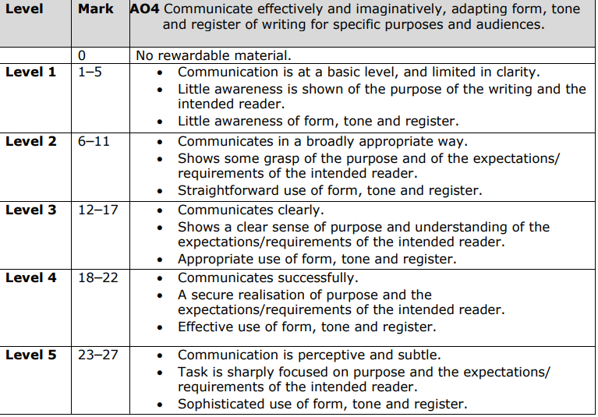
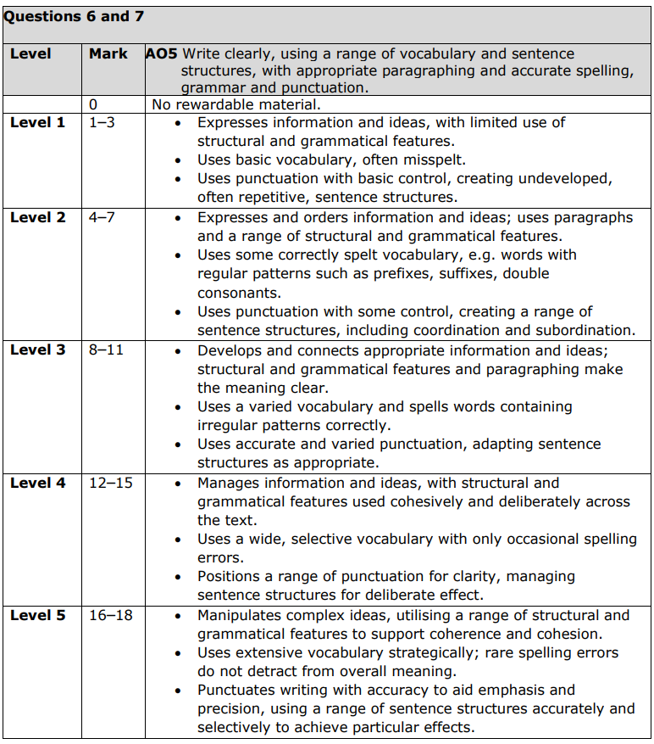

Slide 6

Exploring Setting
Choose one of the setting extracts from ‘Brave New World’
Identify what makes it a good description of the setting
Highlight what you consider to be effective about the setting, be prepared to explain and justify why.
Analyse the language/ structural techniques and consider the authorial choices of Huxley.
Create a list of Success Criteria of what makes a good description of setting. (e.g. High-level adjectives, complex sentences, 5 senses, describing – not telling! etc.)
Notes:
Exploring Setting:
Model analysis of setting, using extracts from the novel or the selection provided, with whole class.
You could provide each student with a different setting extract, or all students with the same one.
Students work through steps 1-3. Students should learn the purpose, function and effect of language (e.g. Adjectives – describe nouns, Adverbs describe verbs, sentence lengths etc.)
Step 4 will generate the Success Criteria for the Creative Writing activity, whereby students use the criteria they’ve generated to create an original dystopian setting. Visual stimuli could also be used to inspire students (See Fred Fordham interpretations, AI generated images or use screenshots from recent films).

Slide 7
'...five hundred and sixty thousand square kilometres, divided into four distinct Sub-Reservations, each surrounded by a high-tension wire fence.'
At this moment, and for no apparent reason, Bernard suddenly remembered that he had left the eau-de-Cologne tap in his bathroom wide open and running.
'...supplied with current from the Grand Canyon hydro-electric station.'
'Cost me a fortune by the time I get back.' With his mind's eye, Bernard saw the needle on the scent meter creeping round and round, ant-like, indefatigably. 'Quickly telephone to Helmholtz Watson.'
'...upwards of five thousand kilometres of fencing at sixty thousand volts.'
'You don't say so,' said Lenina politely, not knowing in the least what the Warden had said, but taking her cue from his dramatic pause. When the Warden started booming, she had inconspicuously swallowed half a gramme of soma, with the result that she could now sit, serenely not listening, thinking of nothing at all, but with her large blue eyes fixed on the Warden's face in an expression of rapt attention.
'To touch the fence is instant death,' pronounced the Warden solemnly. 'There is no escape from a Savage Reservation.'
The word 'escape' was suggestive. 'Perhaps,' said Bernard, half rising, 'we ought to think of going.' The little black needle was scurrying, an insect, nibbling through time, eating into his money.
'No escape,' repeated the Warden, waving him back into his chair.
Notes:
THE RESERVATION – EXTRACT 2

Slide 8
They took their seats in the plane and set off. Ten minutes later they were crossing the frontier that separated civilization from savagery. Uphill and down, across the deserts of salt or sand, through forests, into the violet depth of canyons, over crag and peak and table-topped mesa, the fence marched on and on, irresistibly the straight line, the geometrical symbol of triumphant human purpose. And at its foot, here and there, a mosaic of white bones, a still unrotted carcase dark on the tawny ground marked the place where deer or steer, puma or porcupine or coyote, or the greedy turkey buzzards drawn down by the whiff of carrion and fulminated as though by a poetic justice, had come too close to the destroying wires.
'They never learn,' said the green-uniformed pilot, pointing down at the skeletons on the ground below them. 'And they never will learn,' he added and laughed, as though he had somehow scored a personal triumph over the electrocuted animals.
Bernard also laughed; after two grammes of soma the joke seemed, for some reason, good. Laughed and then, almost immediately, dropped off to sleep and, sleeping, was carried over Taos and Tesuque; over Nambe and Picuris and Pojoaque, over Sia and Cochiti, over Laguna and Acoma and the Enchanted Mesa, over Zuñi and Cibola and Ojo Caliente, and woke at last to find the machine standing on the ground, Lenina carrying the suit-cases into a small square house, and the Gamma-green octoroon talking incomprehensibly with a young Indian.
'Malpais,' explained the pilot, as Bernard stepped out. 'This is the rest-house. And there's a dance this afternoon at the pueblo. He'll take you there.' He pointed to the sullen young savage. 'Funny, I expect.' He grinned. 'Everything they do is funny.' And with that he climbed into the plane and started up the engines. 'Back to-morrow. And remember,' he added reassuringly to Lenina, 'they're perfectly tame; savages won't do you any harm. They've got enough experience of gas bombs to know that they mustn't play any tricks.' Still laughing, he threw the helicopter screws into gear, accelerated, and was gone.
Notes:
THE RESERVATION – EXTRACT 3

Slide 9
But at this moment their guide came back and, beckoning to them to follow, led the way down the narrow street between the houses. They rounded a corner. A dead dog was lying on a rubbish heap; a woman with a goitre was looking for lice in the hair of a small girl. Their guide halted at the foot of a ladder, raised his hand perpendicularly, then darted it horizontally forward. They did what he mutely commanded--climbed the ladder and walked through the doorway, to which it gave access, into a long narrow room, rather dark and smelling of smoke and cooked grease and long-worn, long-unwashed clothes. At the further end of the room was another doorway, through which came a shaft of sunlight and the noise, very loud and close, of the drums.
They stepped across the threshold and found themselves on a wide terrace. Below them, shut in by the tall houses, was the village square, crowded with Indians. Bright blankets, and feathers in black hair, and the glint of turquoise, and dark skins shining with heat. Lenina put her handkerchief to her nose again. In the open space at the centre of the square were two circular platforms of masonry and trampled clay--the roofs, it was evident, of underground chambers; for in the centre of each platform was an open hatchway, with a ladder emerging from the lower darkness. A sound of subterranean flute-playing came up and was almost lost in the steady remorseless persistence of the drums.
Lenina liked the drums. Shutting her eyes she abandoned herself to their soft repeated thunder, allowed it to invade her consciousness more and more completely, till at last there was nothing left in the world but that one deep pulse of sound. It reminded her reassuringly of the synthetic noises made at Solidarity Services and Ford's Day celebrations. 'Orgy-porgy,' she whispered to herself.
Notes:
THE RESERVATION – EXTRACT 4

Slide 10
These drums beat out just the same rhythms.
There was a sudden startling burst of singing--hundreds of male voices crying out fiercely in harsh metallic unison. A few long notes and silence, the thunderous silence of the drums; then shrill, in a neighing treble, the women's answer. Then again the drums; and once more the men's deep savage affirmation of their manhood.
Queer--yes. The place was queer, so was the music, so were the clothes and the goitres and the skin diseases and the old people. But the performance itself--there seemed to be nothing specially queer about that.
'It reminds me of a lower-caste Community Sing,' she told Bernard.
Notes:
THE RESERVATION – EXTRACT 5

Slide 11
For suddenly there had swarmed up from those round chambers underground a ghastly troop of monsters. Hideously masked or painted out of all semblance of humanity, they had tramped out a strange limping dance round the square; round and again round, singing as they went, round and round--each time a little faster; and the drums had changed and quickened their rhythm, so that it became like the pulsing of fever in the ears; and the crowd had begun to sing with the dancers, louder and louder; and first one woman had shrieked, and then another and another, as though they were being killed; and then suddenly the leader of the dancers broke out of the line, ran to a big wooden chest which was standing at one end of the square, raised the lid and pulled out a pair of black snakes. A great yell went up from the crowd, and all the other dancers ran towards him with outstretched hands. He tossed the snakes to the first-comers, then dipped back into the chest for more. More and more, black snakes and brown and mottled--he flung them out. And then the dance began again on a different rhythm. Round and round they went with their snakes, snakily, with a soft undulating movement at the knees and hips. Round and round. Then the leader gave a signal, and one after another, all the snakes were flung down in the middle of the square; an old man came up from underground and sprinkled them with corn meal, and from the other hatchway came a woman and sprinkled them with water from a black jar. Then the old man lifted his hand and, startlingly, terrifyingly, there was absolute silence. The drums stopped beating, life seemed to have come to an end.
Notes:
THE RESERVATION – EXTRACT 6

Slide 12
The old man pointed towards the two hatchways that gave entrance to the lower world. And slowly, raised by invisible hands from below, there emerged from the one a painted image of an eagle, from the other that of a man, naked, and nailed to a cross. They hung there, seemingly self-sustained, as though watching. The old man clapped his hands. Naked but for a white cotton breech-cloth, a boy of about eighteen stepped out of the crowd and stood before him, his hands crossed over his chest, his head bowed. The old man made the sign of the cross over him and turned away. Slowly, the boy began to walk round the writhing heap of snakes. He had completed the first circuit and was half-way through the second when, from among the dancers, a tall man wearing the mask of a coyote and holding in his hand a whip of plaited leather, advanced towards him. The boy moved on as though unaware of the other's existence. The coyote-man raised his whip; there was a long moment of expectancy, then a swift movement, the whistle of the lash and its loud flat-sounding impact on the flesh. The boy's body quivered; but he made no sound, he walked on at the same slow, steady pace. The coyote struck again, again; and at every blow at first a gasp and then a deep groan went up from the crowd. The boy walked on. Twice, thrice, four times round he went. The blood was streaming. Five times round, six times round. Suddenly Lenina covered her face with her hands and began to sob. 'Oh, stop them, stop them!' she implored. But the whip fell and fell inexorably. Seven times round. Then all at once the boy staggered and, still without a sound, pitched forward on to his face. Bending over him, the old man touched his back with a long white feather, held it up for a moment, crimson, for the people to see, then shook it thrice over the snakes. A few drops fell, and suddenly the drums broke out again into a panic of hurrying notes; there was a great shout. The dancers rushed forward, picked up the snakes and ran out of the square. Men, women, children, all the crowd ran after them. A minute later the square was empty, only the boy remained, prone where he had fallen, quite still. Three old women came out of one of the houses, and with some difficulty lifted him and carried him in. The eagle and the man on the cross kept guard for a little while over the empty pueblo; then, as though they had seen enough, sank slowly down through their hatchways, out of sight, into the nether world.
Notes:
THE RESERVATION – EXTRACT 7

Slide 13
The squalor of that little house on the outskirts of the pueblo!
A space of dust and rubbish separated it from the village. Two famine-stricken dogs were nosing obscenely in the garbage at its door. Inside, when they entered, the twilight stank and was loud with flies.
'Linda!' the young man called.
From the inner room a rather hoarse female voice said, 'Coming.'
They waited. In bowls on the floor were the remains of a meal, perhaps of several meals.
The door opened. A very stout blonde squaw stepped across the threshold and stood looking at the strangers, staring incredulously, her mouth open. Lenina noticed with disgust that two of the front teeth were missing. And the colour of the ones that remained... She shuddered. It was worse than the old man. So fat. And all the lines in her face, the flabbiness, the wrinkles. And the sagging cheeks, with those purplish blotches. And the red veins on her nose, the bloodshot eyes. And that neck--that neck; and the blanket she wore over her head--ragged and filthy. And under the brown sack-shaped tunic those enormous breasts, the bulge of the stomach, the hips. Oh, much worse than the old man, much worse! And suddenly the creature burst out in a torrent of speech, rushed at her with outstretched arms and--Ford! Ford! it was too revolting, in another moment she'd be sick--pressed her against the bulge, the bosom, and began to kiss her. Ford! to kiss, slobberingly, and smelt too horrible, obviously never had a bath, and simply reeked of that beastly stuff that was put into Delta and Epsilon bottles (no, it wasn't true about Bernard), positively stank of alcohol. She broke away as quickly as she could.
A blubbered and distorted face confronted her; the creature was crying.
Notes:
THE RESERVATION – EXTRACT 8

Slide 14
There had been accidents. Serious ones. It had been decided to deflect the up-line a few kilometres to the west. Between Grayshott and Tongham four abandoned air-lighthouses marked the course of the old Portsmouth-to-London road. The skies above them were silent and deserted. It was over Selborne, Borden and Farnham that the helicopters now ceaselessly hummed and roared.
The Savage had chosen as his hermitage the old lighthouse which stood on the crest of the hill between Puttenham and Elstead. The building was of ferro-concrete and in excellent condition--almost too comfortable, the Savage had thought when he first explored the place, almost too civilizedly luxurious. He pacified his conscience by promising himself a compensatingly harder self-discipline, purifications the more complete and thorough. His first night in the hermitage was, deliberately, a sleepless one.
In the valley which separated the Hog's Back from the sandy hill on which the lighthouse stood, Puttenham was a modest little village nine stories high, with silos, a poultry farm, and a small vitamin-D factory. On the other side of the lighthouse, towards the south, the ground fell away in long slopes of heather to a chain of ponds.
Beyond them, above the intervening woods, rose the fourteen-story tower of Elstead. Dim in the hazy English air, Hindhead and Selborne invited the eye into a blue romantic distance. But it was not alone the distance that had attracted the Savage to his lighthouse; the near was as seductive as the far. The woods, the open stretches of heather and yellow gorse, the clumps of Scotch firs, the shining ponds with their overhanging birch trees, their water lilies, their beds of rushes--these were beautiful and, to an eye accustomed to the aridities of the American desert, astonishing. And then the solitude! Whole days passed during which he never saw a human being. The lighthouse was only a quarter of an hour's flight from the Charing-T Tower; but the hills of Malpais were hardly more deserted than this Surrey heath. The crowds that daily left London left it only to play Electro-magnetic Golf or Tennis. Puttenham possessed no links; the nearest Riemann-surfaces were at Guildford. Flowers and a landscape were the only attractions here. And so, as there was no good reason for coming, nobody came. During the first days the Savage lived alone and undisturbed.
Notes:
JOHN’S LIGHTHOUSE EXTRACT 1 & 2

Slide 15
Exploring Characters
Choose one of the character descriptions from ‘Brave New World’
Identify what makes it a good character description – what do we find out about them physically and psychologically?
Highlight what you consider to be effective about the description, be prepared to explain and justify why.
Analyse the language/ structural techniques and consider the authorial choices of Huxley.
Create a list of Success Criteria of what makes a good character description. (e.g. High-level adjectives, adverbs to describe verbs)
Notes:
Exploring Character:
Model analysis of character, using extracts from the novel or the selection of relevant quotes about each character, with whole class.
You could provide each student with a different character, or all students with the same character.
Students work through steps 1-3. Students should learn the purpose, function and effect of language (e.g. Adjectives – describe nouns, Adverbs describe verbs etc.)
Step 4 will generate the Success Criteria for the Creative Writing activity, whereby students use the criteria they’ve generated to create an original character, typical of the dystopian genre (i.e. Rebellious Protagonist, Dictator, Oppressed Individual etc.)

Slide 16
‘…twinkle of the white stockings, the sunburnt knees vivaciously bending and unbending, again, again, and the softer rolling of those well-fitted corduroy shorts beneath the bottle-green jacket.’
‘Lenina blushed scarlet; but her eyes, the tone of her voice remained defiant.’
‘in a white acetate-satin sailor suit, and with a round white cap rakishly tilted over her left ear, stood Lenina.’
‘She stepped out of her bell-bottomed trousers. Her zippicamiknicks were a pale shell pink. The Arch-Community-Songster's golden T dangled at her breast.’
'A gramme is better than a damn,' said Lenina mechanically from behind her hands. 'I wish I had my soma!'
‘Her smile flashed redly at him--a row of coral teeth’
‘large blue eyes’
‘her nose was a bit shiny’
'Oh, she's a splendid girl. Wonderfully pneumatic.’ (curvaceous)
‘Beautiful’
‘Her jacket was made of bottle-green acetate cloth with green viscose fur at the cuffs and collar.’
‘her white sailor's blouse’
‘Her face wrinkled up into a grimace of disgust’
‘For all the lupus and the purple eyes, she was uncommonly pretty.’
‘The zippers on Lenina's spare pair of viscose velveteen shorts were at first a puzzle, then, solved, a delight. Zip, and then zip; zip, and then zip... Her green slippers were the most beautiful things he had ever seen.’
‘adorable viscose velveteen shorts’
“Yes, everyone belongs to everyone else.” Lenina repeated slowly and, sighing, was silent for a moment.’
‘Green corduroy shorts and white viscose-woollen stockings turned down below the knee.’
Notes:
Lenina Crowne
Lenina is portrayed as a typical citizen of the World State in Aldous Huxley's ‘Brave New World.’ She embodies the ideals and values of the society, embracing promiscuity, consumption, and conformity.

Slide 17
‘The greatest care is taken to prevent you from loving any one too much… you're so conditioned that you can't help doing what you ought to do. And what you ought to do is on the whole so pleasant, so many of the natural impulses are allowed free play, that there really aren't any temptations to resist. ‘
‘had been a pretty advanced infant—indeed, a quite considerable embryonic achievement.’
‘There isn't any need for a civilized man to bear anything that's seriously unpleasant.’
‘Mustapha Mond leaned forward, shook a finger at them’
‘walked briskly’
“his Fordship”
'We believe in happiness and stability.’
‘meditatively frowning’
‘threw back his head and laughed aloud’
‘genuine scientific curiosity’
‘a man of middle height, black-haired, with a hooked nose, full red lips, eyes very piercing and dark’
‘the cleaner, tidier hair on his head, or face, or chest, or legs, or thighs’
‘A look from Mustapha Mond reduced him to an abject silence’
‘there's always soma to give you a holiday from the facts. And there's always soma to calm your anger, to reconcile you to your enemies, to make you patient and long-suffering… Now, you swallow two or three half-gramme tablets, and there you are. Anybody can be virtuous now.’
Notes:
Mustapha Mond:
The Resident World Controller for Western Europe, Mustapha Mond, appears only briefly in the novel.
‘Mustapha Mond, Resident World Controller of Western Europe, paused, then dropped his tone to a very confidential whisper. “But, my dear chap,' he said genially, 'that's precisely why I'm here. Precisely why I wanted to see you.”’
‘With Mustapha Mond, it was a case of genuine scientific curiosity.’
‘Mustapha Mond, on the other hand, had been a pretty advanced infant—indeed, a quite considerable embryonic achievement. Such a splendidly pneumatic bottle was the result of his upbringing.’
‘Mustapha Mond, for the sake of the cleaner, tidier hair on his head, or face, or chest, or legs, or thighs, was at pains to encourage the feminine preference for the male.’
‘Resident World Controller for Western Europe walked briskly into the room.’
‘His fordship Mustapha Mond! The eyes of the saluting students almost popped out of their heads. Mustapha Mond! The Resident Controller for Western Europe! One of the Ten World Controllers. One of the Ten...’
‘The corners of his red lips twitched ironically’
‘Mustapha Mond leaned forward, shook a finger at them’
‘Mustapha Mond's anger gave place almost at once to mirth. The idea of this creature solemnly lecturing him--him--about the social order was really too grotesque. The man must have gone mad. 'I ought to give him a lesson,' he said to himself; then threw back his head and laughed aloud. For the moment, at any rate, the lesson would not be given.’
‘He sat for some time, meditatively frowning’
‘A look from Mustapha Mond reduced him to an abject silence’
'We believe in happiness and stability. A society of Alphas couldn't fail to be unstable and miserable. Imagine a factory staffed by Alphas--that is to say by separate and unrelated individuals of good heredity and conditioned so as to be capable (within limits) of making a free choice and assuming responsibilities. Imagine it!' he repeated.’
'And I've got plenty more,' Mustapha Mond continued, resuming his seat. 'A whole collection of pornographic old books. God in the safe and Ford on the shelves.' He pointed with a laugh to his avowed library--to the shelves of books, the racks full of reading-machine bobbins and sound-track rolls.’
'But people never are alone now,' said Mustapha Mond. 'We make them hate solitude; and we arrange their lives so that it's almost impossible for them ever to have it.’
'Come, come,' protested Mustapha Mond, 'that's going rather far, isn't it?’
‘There isn't any need for a civilized man to bear anything that's seriously unpleasant.’
‘'My dear young friend,' said Mustapha Mond, 'civilization has absolutely no need of nobility or heroism. These things are symptoms of political inefficiency. In a properly organized society like ours, nobody has any opportunities for being noble or heroic. Conditions have got to be thoroughly unstable before the occasion can arise. Where there are wars, where there are divided allegiances, where there are temptations to be resisted, objects of love to be fought for or defended--there, obviously, nobility and heroism have some sense. But there aren't any wars nowadays. The greatest care is taken to prevent you from loving any one too much. There's no such thing as a divided allegiance; you're so conditioned that you can't help doing what you ought to do. And what you ought to do is on the whole so pleasant, so many of the natural impulses are allowed free play, that there really aren't any temptations to resist. And if ever, by some unlucky chance, anything unpleasant should somehow happen, why, there's always soma to give you a holiday from the facts. And there's always soma to calm your anger, to reconcile you to your enemies, to make you patient and long-suffering. In the past you could only accomplish these things by making a great effort and after years of hard moral training. Now, you swallow two or three half-gramme tablets, and there you are. Anybody can be virtuous now. You can carry at least half your morality about in a bottle. Christianity without tears--that's what soma is.‘’

Slide 18
‘The dress of the young man who now stepped out on to the terrace was Indian; but his plaited hair was straw-coloured, his eyes a pale blue, and his skin a white skin, bronzed.’
‘Tears stood in the young man's eyes; he was ashamed and turned away.’
‘he turned with a proud squaring of the shoulders, a proud, defiant lifting of the chin’
‘such a nice-looking boy, she was thinking, and a really beautiful body. The blood rushed up into the young man's face’
‘mad eyes’
‘He ground his teeth’
‘The Savage was busy on his arrows. Thirty hazel sticks had been whittled and dried, tipped with sharp nails, carefully nocked. He had made a raid one night on the Puttenham poultry farm, and now had feathers enough to equip a whole armoury.’
‘…Indians came running along the path. Their black hair was braided with fox fur and red flannel. Cloaks of turkey feathers fluttered from their shoulders; huge feather diadems exploded gaudily round their heads. With every step they took came the clink and rattle of their silver bracelets, their heavy necklaces of bone and turquoise beads. They came on without a word, running quietly in their deerskin moccasins.’
‘clenched his fists’
‘stripped to the waist and hitting himself with a whip of knotted cords. His back was horizontally streaked with crimson, and from weal to weal ran thin trickles of blood.’
‘a sharp stone cut his cheek. The blood wouldn’t stop; he was covered with blood’
‘He ran across the room and stabbed--oh, the blood!--stabbed again’
'I'll kill him, I'll kill him, I'll kill him,' he kept saying.
Notes:
John the Savage
John the Savage is presented as a pivotal character in Aldous Huxley's ‘Brave New World,’ serving as a contrast to the highly regimented and pleasure-driven society of the World State.
Outsider and Cultural Contrast:
John is introduced as an outsider to the World State, having been raised on the Savage Reservation where he was exposed to traditional values, literature, and religious beliefs. His upbringing stands in stark contrast to the conditioned existence of the citizens of the World State, making him a symbol of cultural clash and dissent.
Struggle with Identity and Belonging:
Throughout the novel, John grapples with his identity and sense of belonging. Despite his upbringing, he is drawn to the world of the World State, particularly to Lenina Crowne. However, he struggles to reconcile his own values and emotions with the superficiality and hedonism of the society he encounters.
Voice of Dissent and Critique:
John serves as a voice of dissent against the dehumanising effects of the World State's conditioning and social engineering. He expresses his disgust with the lack of individuality, genuine emotion, and meaningful human connection in the society he encounters. His critique serves as a commentary on the dangers of sacrificing individuality and freedom for the sake of societal stability and conformity.
Symbol of Humanity and Authenticity:
Despite his flaws and struggles, John embodies qualities of humanity, authenticity, and passion that are lacking in the world of the World State. His adherence to traditional values, his capacity for love and suffering, and his commitment to principles of morality and self-awareness make him a symbol of human resilience and potential.
Huxley uses John the Savage to convey his message to the audience about the importance of individuality, critical thinking, and the preservation of human values in the face of technological advancement and societal control. Through John's experiences and struggles, Huxley warns against the dangers of sacrificing human dignity and freedom in pursuit of a utopian ideal based on superficial happiness and efficiency.

Slide 19


Dating Profile Disaster
You are working for a Dating App in the World State.
Your job is to create online dating profiles for John and Lenina. They must use details from Chapter 13 to describe their ideal partner, their views on love/sex, and their expectations for a relationship.
Success Criteria:
Create two separate profiles, one for John and one for Lenina.
Bio
Looking For…
Deal Breakers…
Likes/ Dislikes…
Quote from their character from Chapter 13.
After creating the profiles, you should write a short paragraph explaining why these two characters are fundamentally incompatible, referencing their profiles and specific events from the chapter.

Slide 20
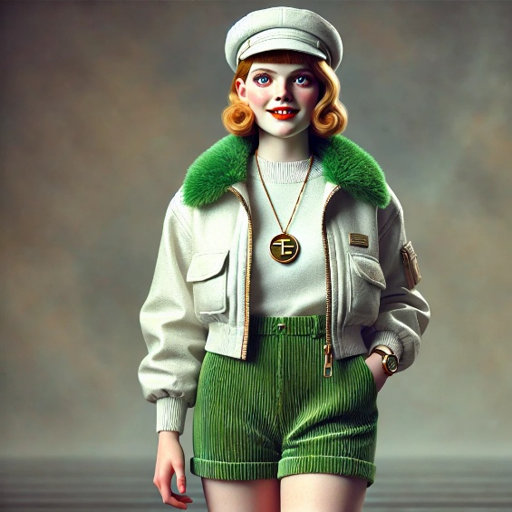
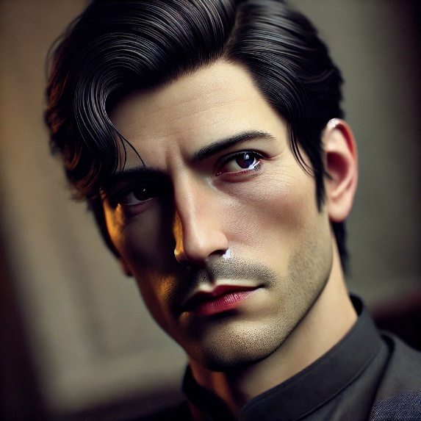
Drawing the Characters
Choose one of the characters you have just analysed.
Paying close attention to Huxley’s descriptions and using your inference skills, draw them using the mannequin templates provided.
Below are some examples of what to draw:
Facial expressions
Their physical appearance
Clothes (relevant colours)
Props - things they might be holding or ingesting.
Notes:
Exploring Characters - Differentiated tasks: Students must choose one to complete

Slide 21
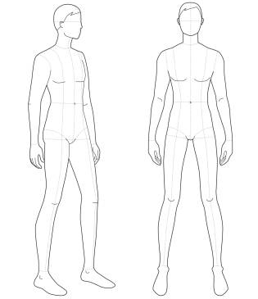
Notes:
Drawing Template 1

Slide 22
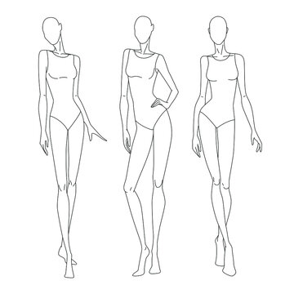
Notes:
Drawing Template 2

Slide 23

Imagine you are a World State media reporter covering the 'soma riot' at the Hospital for the Dying.
Write a sensationalized newspaper headline and a short (1-2 paragraph) news report describing the event.
The report must reflect the World State's perspective, downplaying the "disorder" and framing John's actions as abnormal or even amusing – humiliate the outsider.
It should highlight the efficiency of the Police and the quick return to "stability."
Students can optionally create a short "soundbite" from a World State citizen expressing their confusion or disapproval of John's behaviour.
Success Criteria:
Purpose: to write an article for a newspaper – informative and persuasive.
Audience: general readership of a newspaper.
Form: candidates may use some stylistic conventions of an article, such as heading, sub-heading or occasional use of bullet points. Candidates should not include features of layout such as pictures or columns. There should be a clear organisation with an introduction, development of points and a conclusion.

Slide 24


Recap Mustapha Mond's arguments for sacrificing "high art," pure science, and individual freedom for the sake of social stability and happiness.
As a class or in small groups, identify key phrases and ideas from Chapter 16 where Mond justifies the suppression of art (like Shakespeare) and pure science. (e.g., "stability isn't nearly so spectacular as instability," "beauty's a tortoise," "science is dangerous").
Look at the famous propaganda posters on the next slide. Write down, analyse and explain what made such posters effective/ persuasive – draw up success criteria for the creative task to come.

Slide 25


Notes:
Ask students to analyse and explain what made such posters effective/ persuasive – draw up success criteria for the creative task to come.

Slide 26
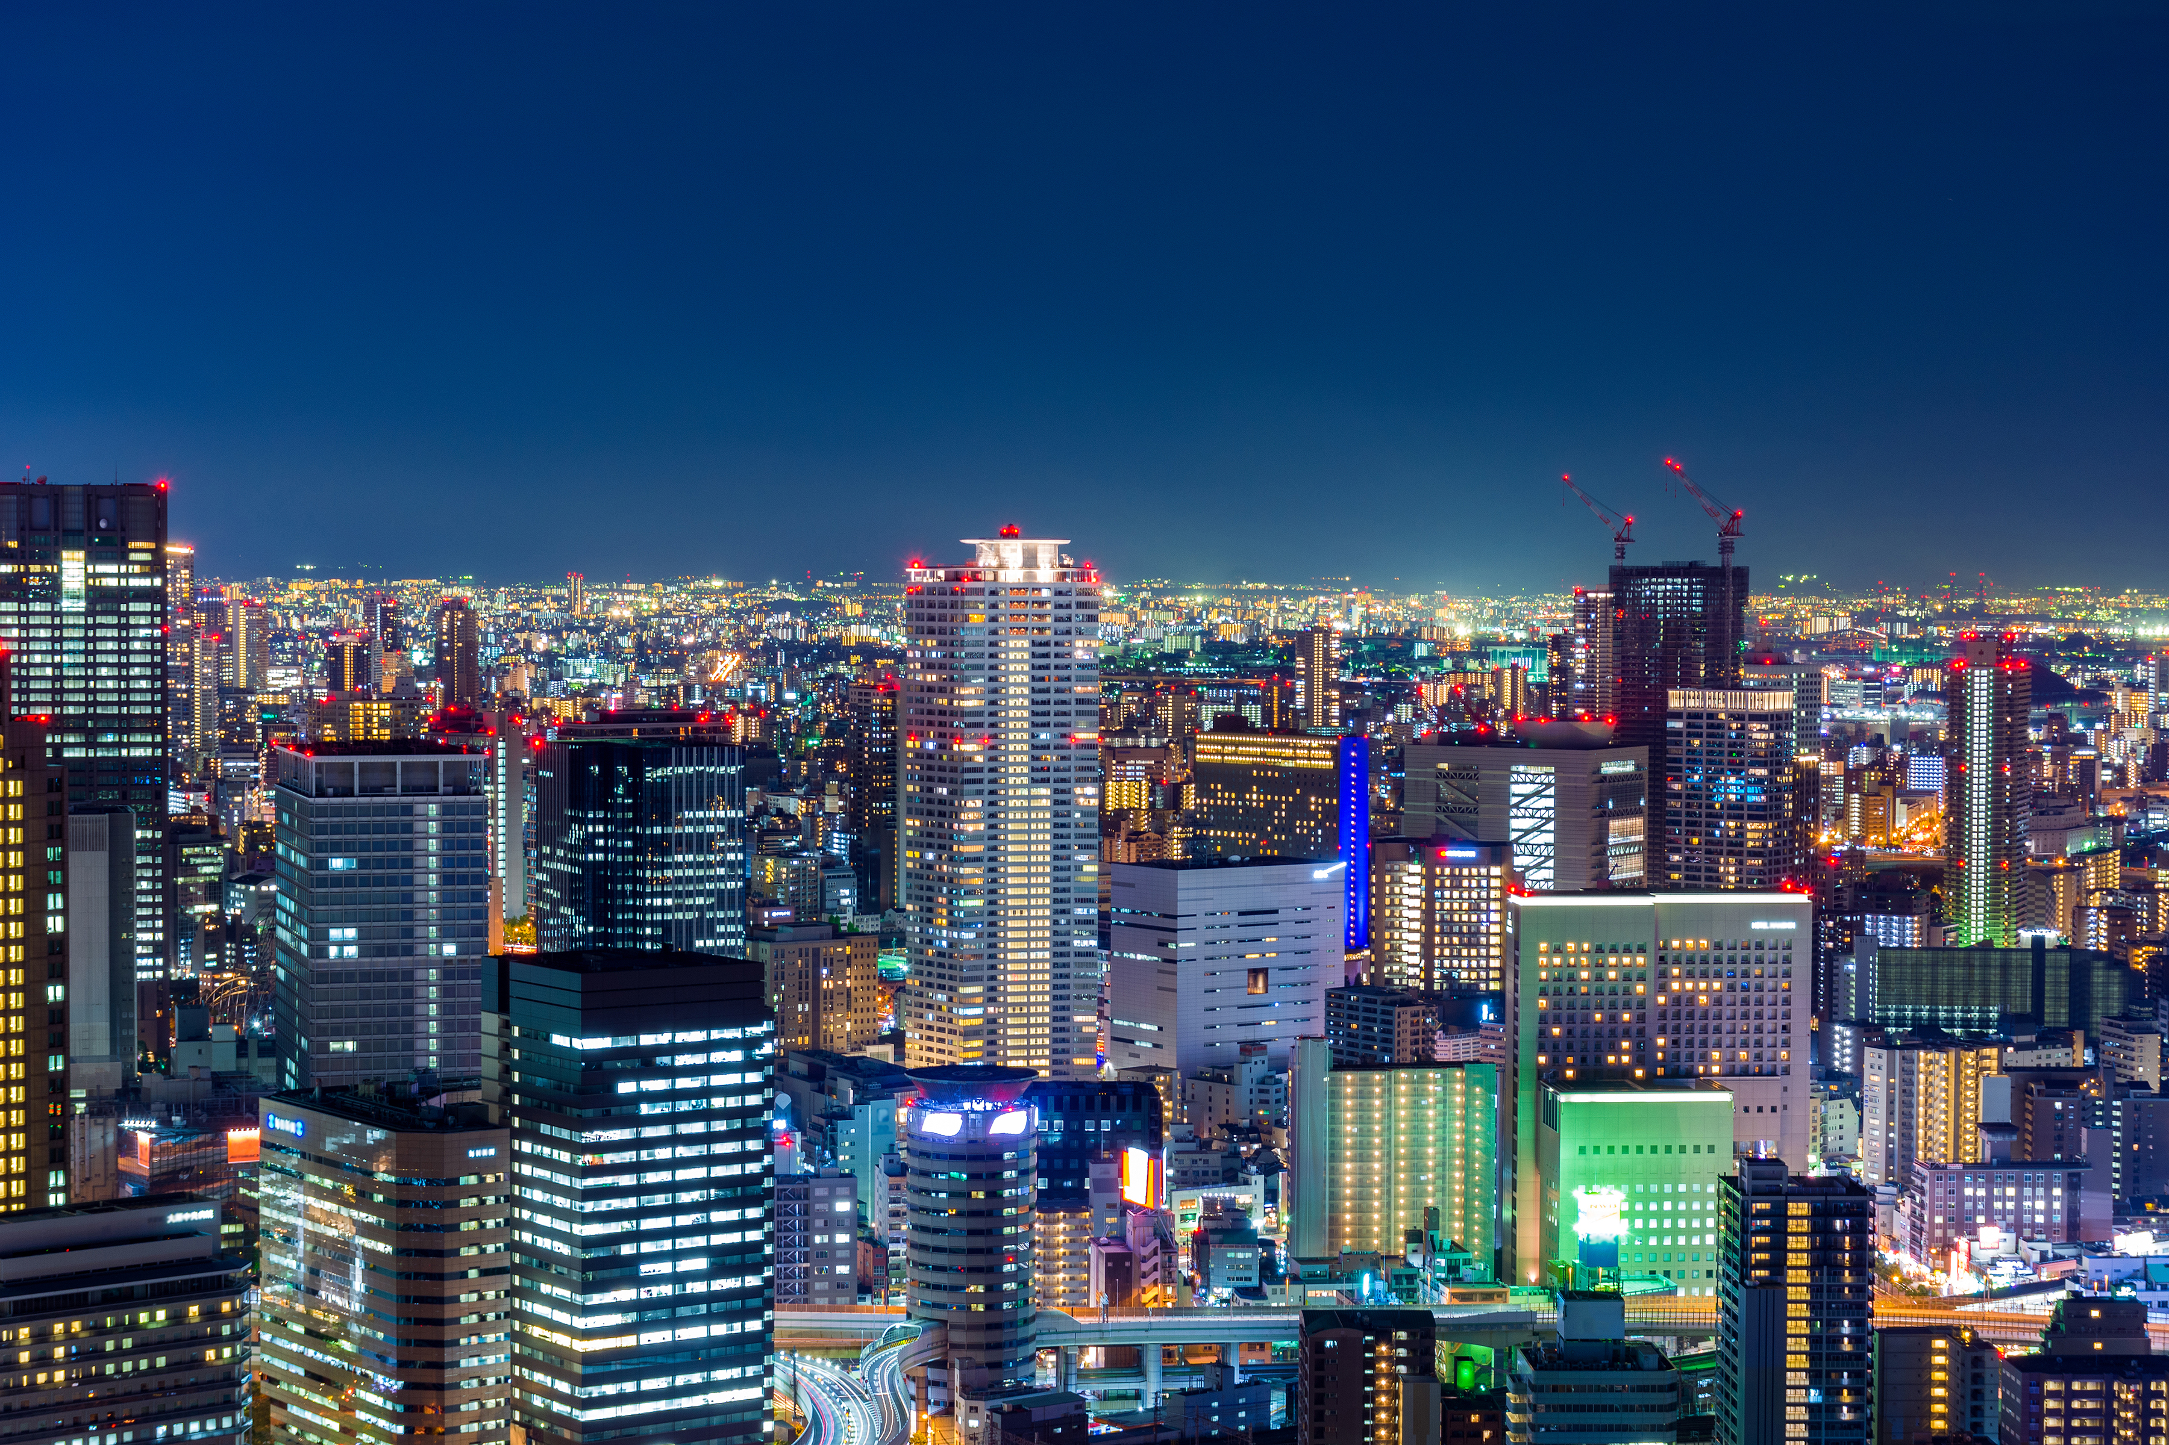
Success Criteria:
Visual: Looks like it came from the World State - Orderly, clean, perhaps a bit too cheerful or sterile. Think bright, simple colours.
Images: Use pictures or symbols that clearly show the World State's message (e.g., smiling faces, symbols of stability, absence of messy emotions).
Clear Layout: Easy to read and understand quickly. The most important parts should stand out.
Catchy Slogan: A short, memorable phrase (like a jingle or motto) that sounds like something the World State would say.
Variety of Language Devices/ Persuasive techniques: Alliteration (e.g., "Soma Smooths Suffering"), Rhyme (e.g., "Feelies, Friendlies, Fun for All"), Simple commands/Imperatives (e.g., "Consume More!," "Be Happy!").
Connecting to Chapter 16 (Content):Mond's Main Points: The poster must clearly show ideas that Mustapha Mond talks about in Chapter 16. (For example: Why old art (like Shakespeare) is bad for stability. Why too much pure science is dangerous. Why happiness is more important than truth or freedom.
Your Explanation & Why You Chose That: Briefly explain how your poster's words, pictures, and colors directly connect to Mond's arguments in Chapter 16 and what the World State wants people to believe.
Design a propaganda poster from the World State's perspective.
Creatively represent the World State's ideology as presented by Mustapha Mond regarding art, science, and stability.

Slide 27


Create a Podcast Episode Script for,
'The Future of Humanity: Happiness vs. Truth'
Objective: To analyse and present the core philosophical debate between John (the Savage) and Mustapha Mond from Chapter 17, using a modern podcast format.
Context: Imagine a futuristic podcast (perhaps from a rebel group, an underground intellectual network, or even a satirical World State-approved show) that dares to explore controversial ideas.
Your episode will focus on the pivotal conversation in Mustapha Mond's office.
Notes:
Activity Instructions:
Form Your Team: Work in groups of 2-3 students.
Assign Roles (or let all write for all):
Host/Moderator: Guides the discussion, introduces guests, asks questions.
John (The Savage): Presents his arguments for suffering, God, poetry, freedom, etc.
Mustapha Mond (World Controller): Defends the World State's engineered happiness, stability, and lack of "truth" or "old things." (Optional: You could also include a "Listener Caller" or "Expert Commentator" voice for extra complexity).
Review Chapter 17: Re-read this chapter carefully, highlighting key arguments, memorable quotes, and the specific ideas each character champions or condemns. Pay attention to how they speak.
Outline Your Episode:
Introduction (Host): Hook the listener, introduce the topic ("Happiness vs. Truth," "The Savage's Challenge"), and introduce your "guests."
Main Debate Segment: This is the core. Write dialogue where John and Mond go back and forth on their main points. Focus on:
The necessity (or lack thereof) of suffering.
The role of God/religion.
The value of truth vs. happiness.
The meaning of freedom.
The place of art and poetry (building on Chapter 16 discussions).
Host Interventions: The host should guide the conversation, ask clarifying questions, or summarize points.
Conclusion (Host): Briefly summarize the debate, perhaps leave the listener with a thought-provoking question, and sign off.
Script Your Podcast (2-4 pages, double-spaced): Write out the full dialogue for each character. Include notes for:
Speaker Names: Clearly label who is speaking.
Tone/Delivery: (e.g., [John, passionately], [Mond, calmly dismissive], [Host, thoughtful]).
Sound Cues (Optional but fun!): (e.g., [Sound of a faint, unsettling hum], [Quick, cheerful jingle], [Slight static interference]).
Practice/Perform: If time allows, practice reading your script aloud to hear how it sounds.
Success Criteria: Podcast Episode Script
Podcast Format & Structure:
Clear Roles: It's obvious who is speaking (Host, John, Mond).
Smooth Flow: The episode has a clear introduction, a logical debate segment, and a conclusion.
Engagement: The script is written to keep a listener interested (e.g., not just a monologue).
(Optional: Effective use of suggested sound cues).
Character Voice & Accuracy (Language & Content):
Authentic John: John's dialogue reflects his passion, his love for Shakespeare, his idealism, and his strong moral convictions from Chapter 17.
Authentic Mond: Mond's dialogue reflects his calm, logical, and dismissive tone, his pragmatism, and his well-reasoned (from his perspective) justifications for the World State's systems.
Accurate Arguments: Both characters clearly present their main arguments as they are discussed in Chapter 17 regarding suffering, God, truth, happiness, etc. (e.g., John's "right to be unhappy," Mond's "Christianity without tears").
Philosophical Depth & Theme Exploration (Content):
Core Conflict: The script clearly highlights the central philosophical conflict between John and Mond.
Thematic Understanding: It shows a good understanding of the novel's key themes (e.g., individuality vs. conformity, freedom vs. stability, artificial happiness vs. true human experience).
Thought-Provoking: The debate feels significant and makes the audience think about these complex ideas.
Language & Engagement (Language Devices & Style):
Dynamic Dialogue: The conversation isn't just a series of statements; characters genuinely respond to each other.
Effective Language Devices: Use of rhetorical questions (e.g., "But at what cost, Controller?"), strong declarative statements, imagery, and persuasive language.
Appropriate Tone: The tone of the podcast (e.g., serious, satirical, investigative) is consistent and serves the purpose.
Connection to Text:
Specific References: The dialogue directly or indirectly uses key ideas, phrases, or concepts from Chapter 17 (and potentially 16) to support arguments.

Slide 28

Introduction (Host):
Hook the listener, introduce the topic ("Happiness vs. Truth," "The Savage's Challenge"), and introduce your "guests."
Main Debate Segment:
This is the core.
Write dialogue where John and Mond go back and forth on their main points.
Focus on:
The necessity (or lack thereof) of suffering.
The role of God/religion.
The value of truth vs. happiness.
The meaning of freedom.
The place of art and poetry (building on Chapter 16 discussions).
Host Interventions:
The host should guide the conversation, ask clarifying questions, or summarize points.
Conclusion (Host):
Briefly summarize the debate, perhaps leave the listener with a thought-provoking question, and sign off.
Script Your Podcast
Write out the full dialogue for each character.
Include:
Speaker Names: Clearly label who is speaking.
Tone/Delivery:
(e.g., [John, passionately], [Mond, calmly dismissive], [Host, thoughtful]).
Sound Cues (Optional but fun!):
(e.g., [Sound of a faint, unsettling hum], [Quick, cheerful jingle], [Slight static interference]).
Practice/Perform: If time allows, practice reading your script aloud to hear how it sounds.
Notes:
Success Criteria: Podcast Episode Script
Podcast Format & Structure:
Clear Roles: It's obvious who is speaking (Host, John, Mond).
Smooth Flow: The episode has a clear introduction, a logical debate segment, and a conclusion.
Engagement: The script is written to keep a listener interested (e.g., not just a monologue).
(Optional: Effective use of suggested sound cues).
Character Voice & Accuracy (Language & Content):
Authentic John: John's dialogue reflects his passion, his love for Shakespeare, his idealism, and his strong moral convictions from Chapter 17.
Authentic Mond: Mond's dialogue reflects his calm, logical, and dismissive tone, his pragmatism, and his well-reasoned (from his perspective) justifications for the World State's systems.
Accurate Arguments: Both characters clearly present their main arguments as they are discussed in Chapter 17 regarding suffering, God, truth, happiness, etc. (e.g., John's "right to be unhappy," Mond's "Christianity without tears").
Philosophical Depth & Theme Exploration (Content):
Core Conflict: The script clearly highlights the central philosophical conflict between John and Mond.
Thematic Understanding: It shows a good understanding of the novel's key themes (e.g., individuality vs. conformity, freedom vs. stability, artificial happiness vs. true human experience).
Thought-Provoking: The debate feels significant and makes the audience think about these complex ideas.
Language & Engagement (Language Devices & Style):
Dynamic Dialogue: The conversation isn't just a series of statements; characters genuinely respond to each other.
Effective Language Devices: Use of rhetorical questions (e.g., "But at what cost, Controller?"), strong declarative statements, imagery, and persuasive language.
Appropriate Tone: The tone of the podcast (e.g., serious, satirical, investigative) is consistent and serves the purpose.
Connection to Text:
Specific References: The dialogue directly or indirectly uses key ideas, phrases, or concepts from Chapter 17 (and potentially 16) to support arguments.

Slide 29
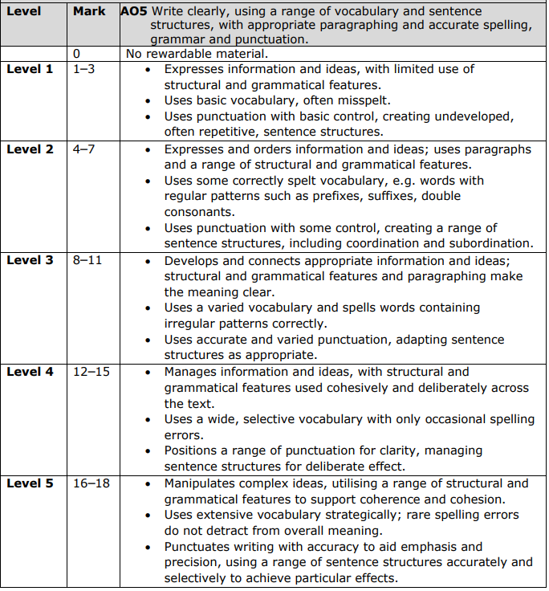
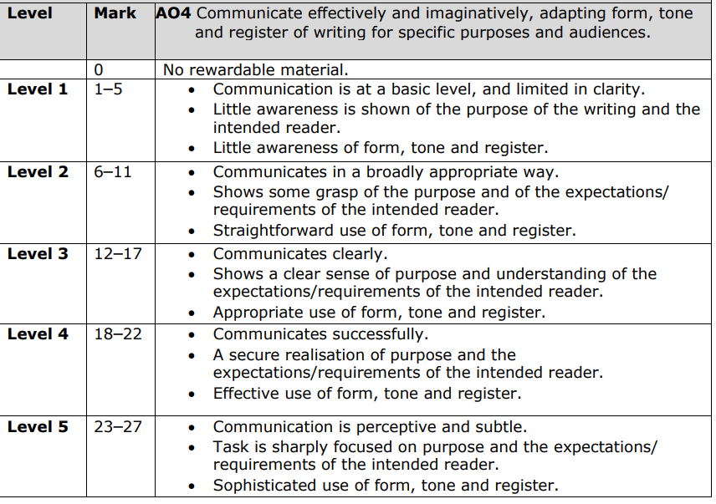

Slide 30
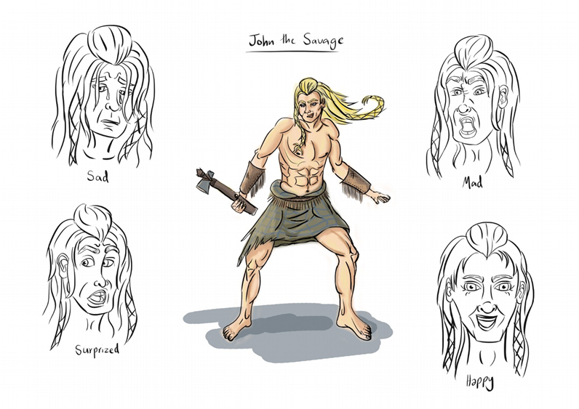
You are now John the savage.
Choose one of the tasks below to complete:
Write a single or series of journal entries covering the days/hours leading up to John's final act, reflecting his deteriorating mental state, his reflections on his experiences, and his increasing despair.
Write an unsent letter addressed to an imagined recipient (e.g., Bernard, Helmholtz, or even an abstract "humanity"), expressing his final thoughts, disillusionment, and reasons for his despair.
Success Criteria:
The writing should capture John's voice
Contain echoes of Shakespearean language
Reflect John's disillusionment with the World State
Capture his feelings about Lenina
Mention the constant invasion by the "pilgrims" and media
Express his feeling of being trapped or contaminated

